Slide 1


ORIAN LOUANT
University of Liège
EuroCC National Competence Center for Belgium
LUMI User Support Team
HPC Workflow Training @ENCCB – February 15-16, 2022

Slide 2
A Snakemake workflow is
defined in terms of rules that represent the different steps of your data analysis. These rules are described via a human readable, Python based language
can entail a description of required software with an integration with the Conda package manager and container virtualization
independent of the available resources and computing platform
Snakemake is a workflow management system to create reproducible and scalable data analyses

Slide 3
Workflow definition

Slide 4
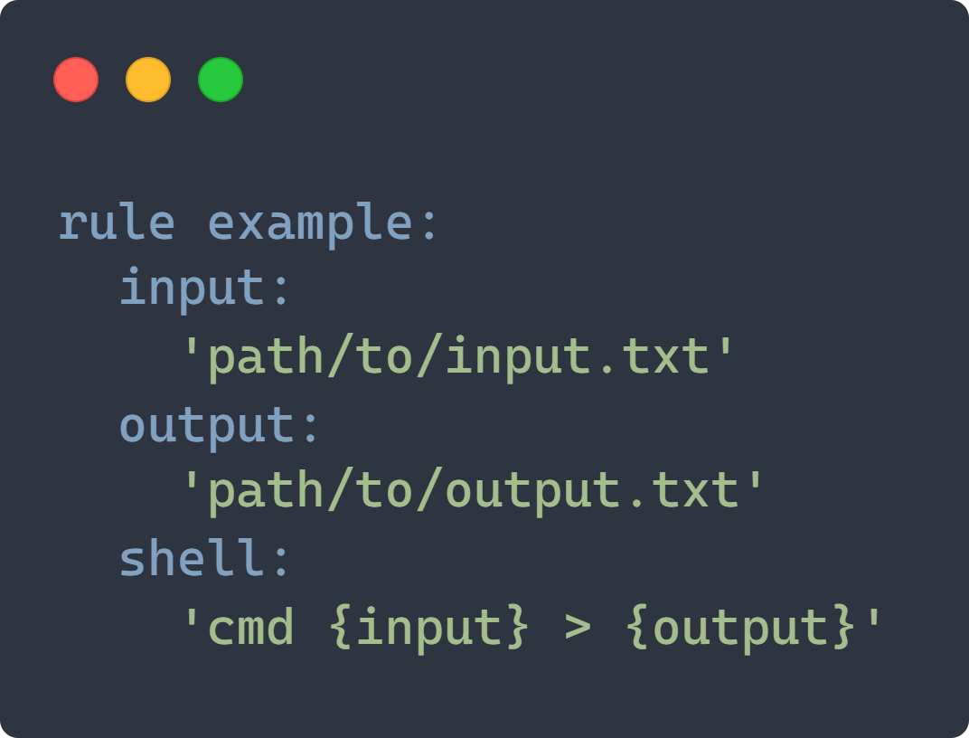
Snakemake Rules
Rules describe how to get output files from input files
A shell command or a script to generate the output from the input
By default, Snakemake will look for rules in a file named Snakefile
Dependencies between the rules are determined automatically, creating a DAG (directed acyclic graph) of jobs

Slide 5
Demo time

Slide 6


https://mybinder.org/v2/gh/olouant/enccb-workflow-snakemake/master
https://github.com/olouant/enccb-workflow-snakemake

Slide 7
Reproducibility

Slide 8
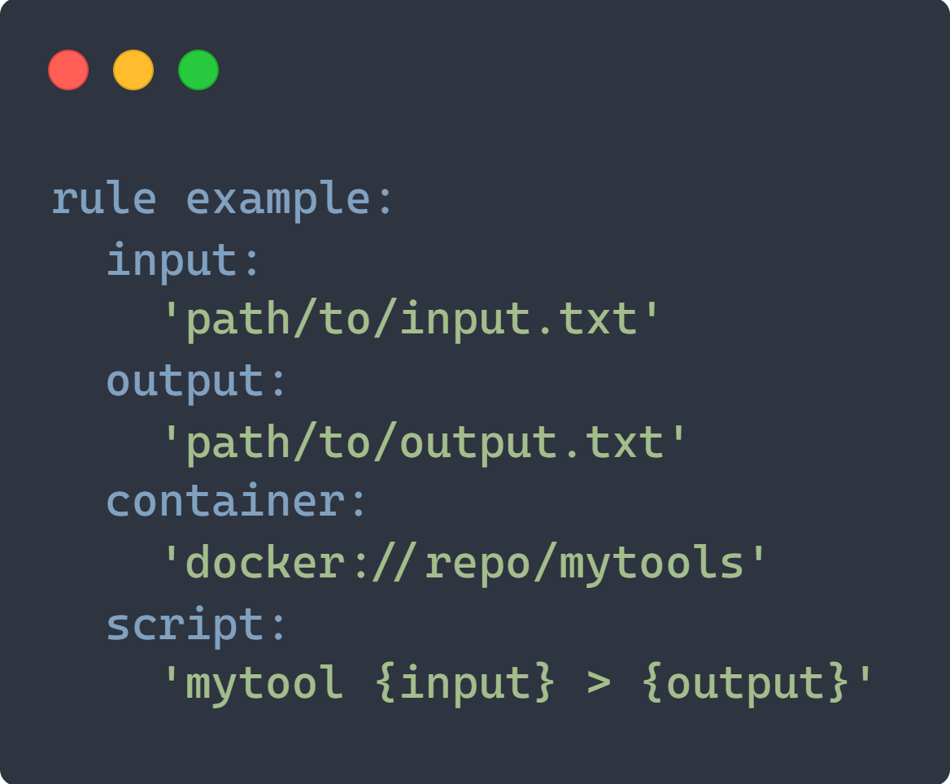
Using Containers
For each rules in your workflow, you can specify a container to use with the container directive
To run the rules that define a container within singularity, use the –-use-singularity option
You can use URLs starting with docker:// or shub://

Slide 9
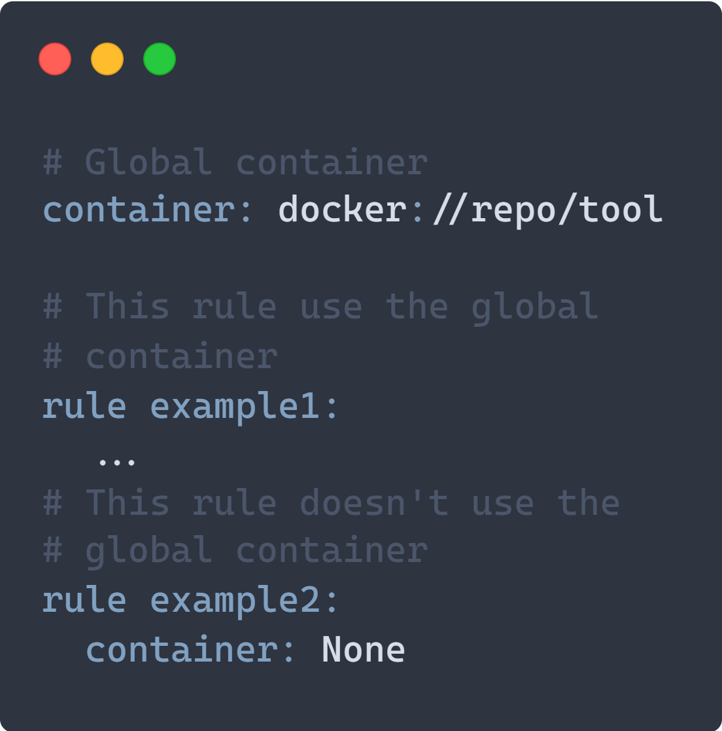
Using Containers
The container directive can be used to define a global container
When you define a global container, all the jobs will use this container
You can disable the use of the global container for certain rules by setting value for the container directive to None

Slide 10
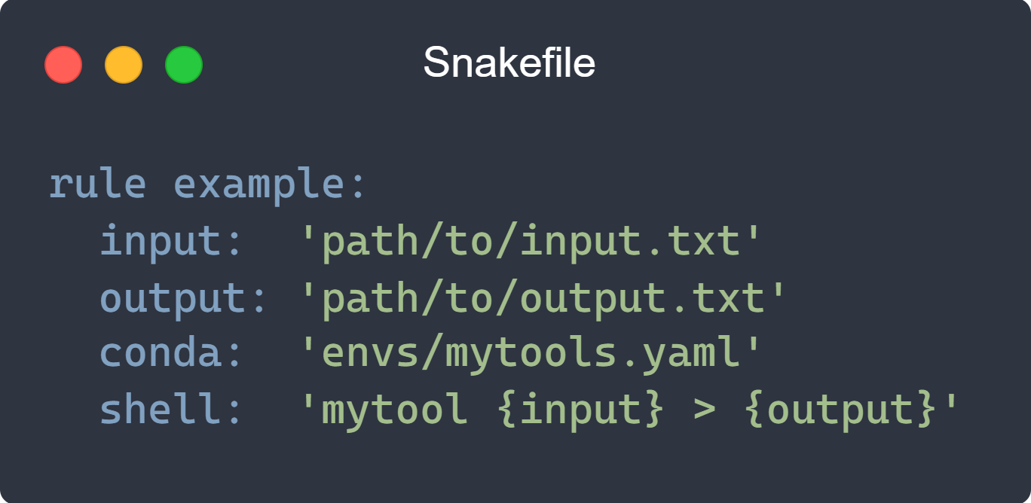
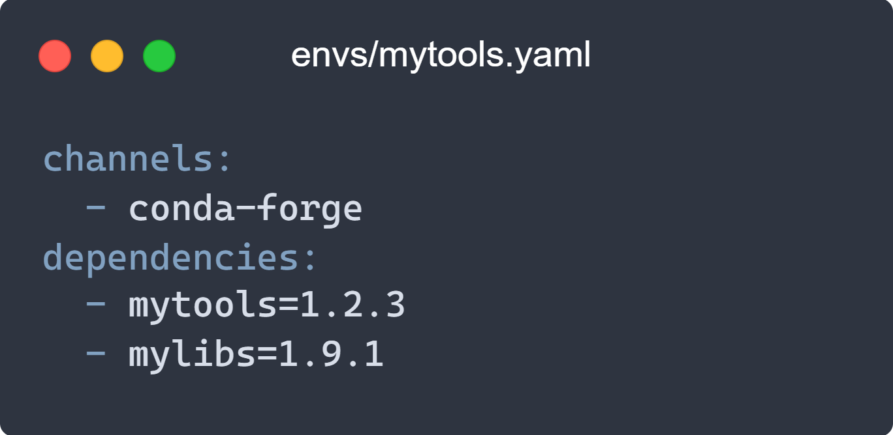
Define a Conda Environment
You can define an isolated software environment per rule using the conda directive that takes as argument a YAML file describing the Conda packages to use
To use the Conda integration add the –-use-conda option when launching Snakemake

Slide 11
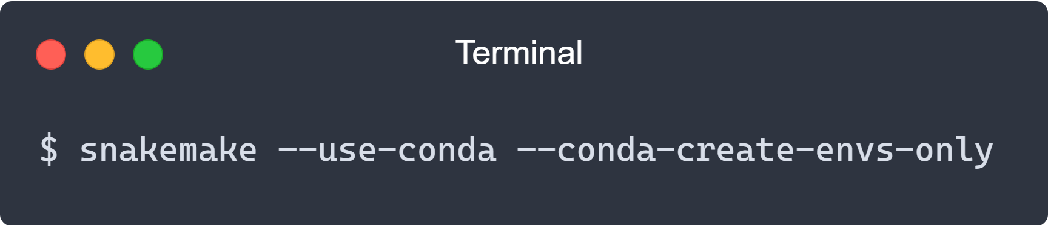
Create the Environment Before Running the Workflow
In some cases, when running in a HPC environment the compute nodes do not have internet access and the creation of the Conda environment will fail
Solution is to create the Conda environment on the login node but not run the full workflow

Slide 12
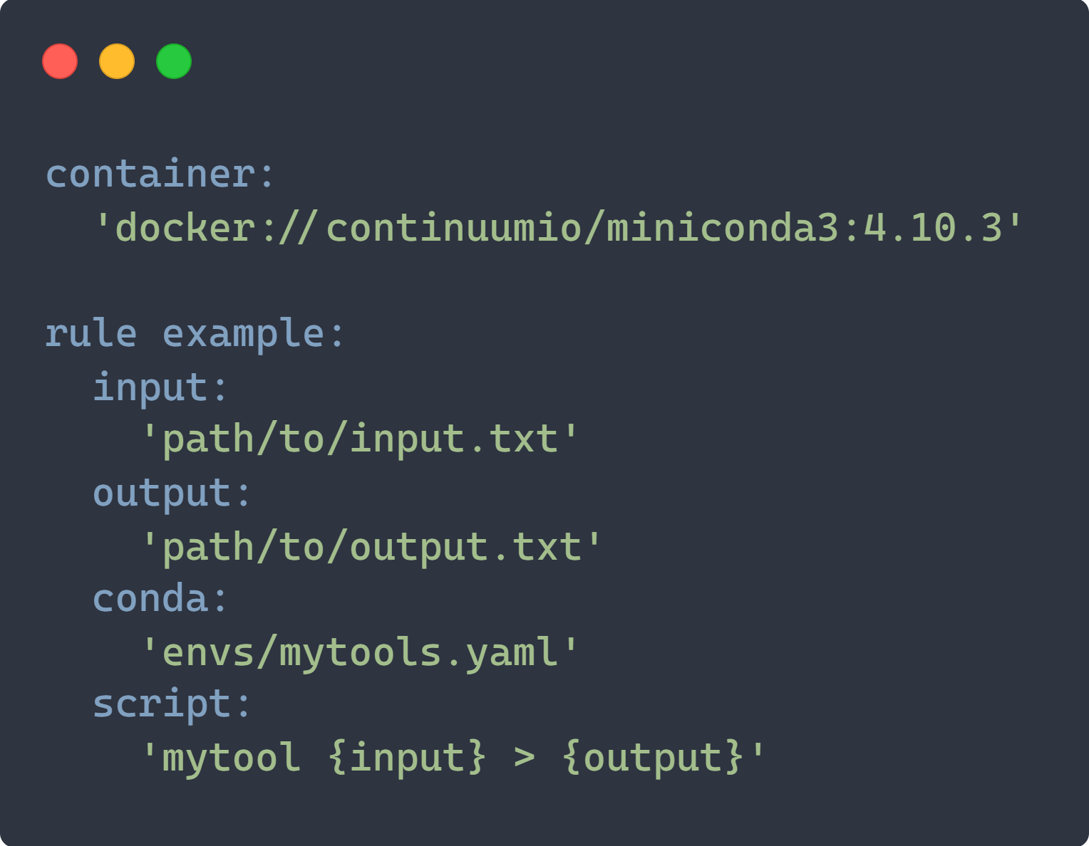
Combining Conda and Container
Snakemake allows you to combine the definition of a Conda environment with running jobs in containers
In that case you need to invoke Snakemake with both the –-use-conda and -–use-singularity options

Slide 13
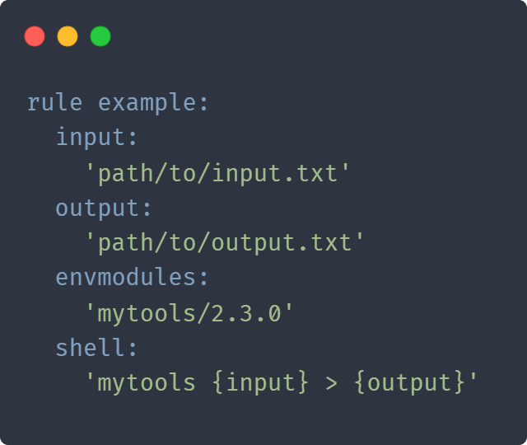
Using Environment Modules
Snakemake allows to define environment modules per rule using the envsmodules directive to provide a list of modules that should be loaded in the environment
To use environment modules add the –-use-envmodules option when launching Snakemake

Slide 14
Scalability

Slide 15
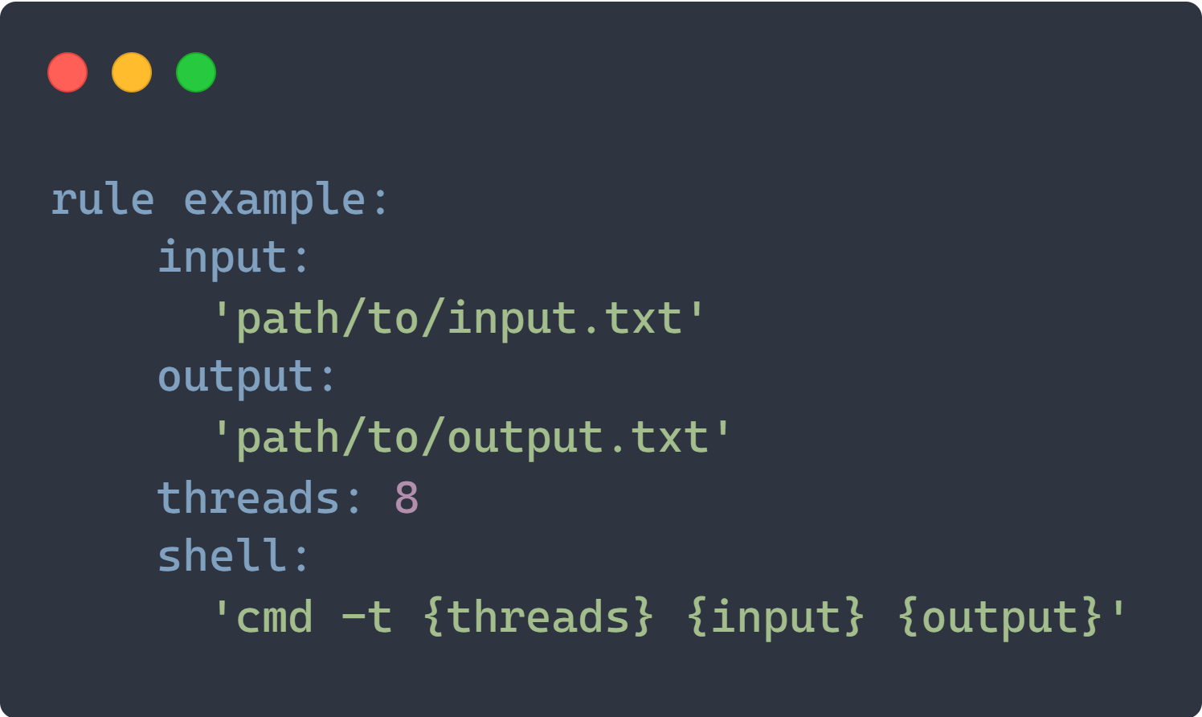
Setting the Number of Threads
You can specify the number of threads to use for a specific rule with the threads directive
Snakemake will set common environment variables to the value given of the threads directive:
OMP_NUM_THREADS
OPENBLAS_NUM_THREADS
MKL_NUM_THREADS

Slide 16
Setting the Number of Threads
Specified threads must be seen as a maximum
When Snakemake is executed with fewer cores, the number of threads will be adjusted:
threads = min(threads, cores)
with cores, the number of cores specified at the command line
(--cores option)

Slide 17
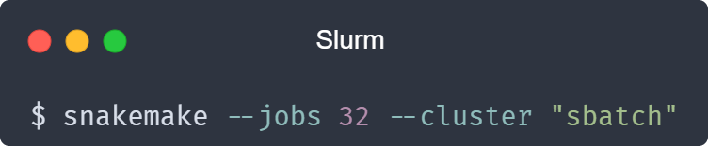
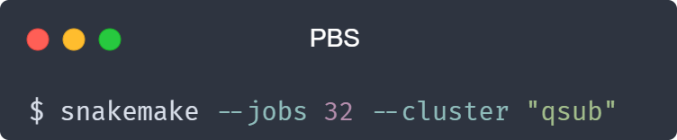
Running on an HPC cluster
Snakemake can compile jobs into scripts that will run on the compute node of and HPC cluster
The jobs are submitted to the cluster via a submission command that is provided by passing the --cluster option to the command line
The maximum number of jobs to be submitted at once is set using the --jobs option

Slide 18
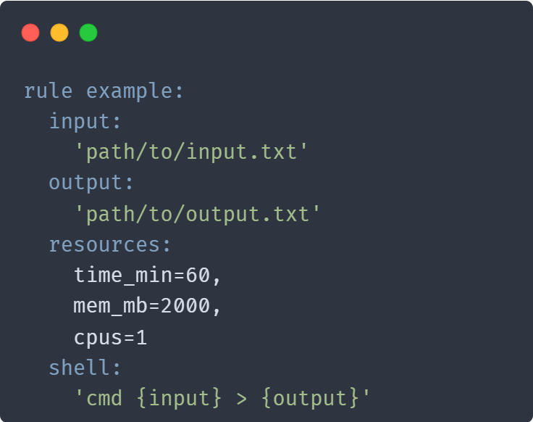
Managing Resources
Running on in a cluster environment may require resources definition that are defined using the resources directive
There are 3 standard resources used by Snakemake:
mem_mb: memory usage
disk_mb: disk usage
tmpdir: temporary directory
Resources that shall constrain the scheduling are specified using the --resources command line option

Slide 19
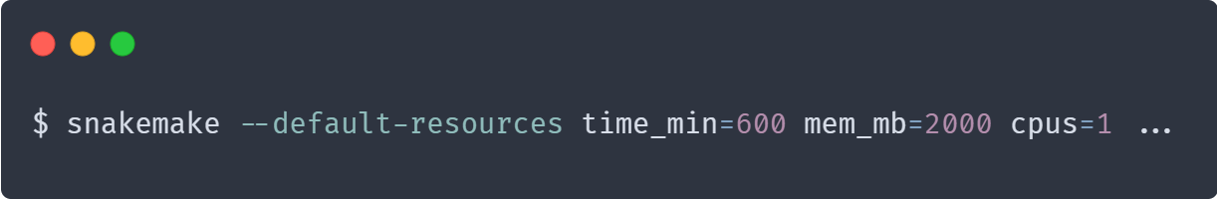
Managing Resources and Cluster Execution
Resources for rules that do not define explicitly resources can be provided through the command line option --default-resources
Resources defined within the rules can be overwitted using the command line option --set-resources

Slide 20
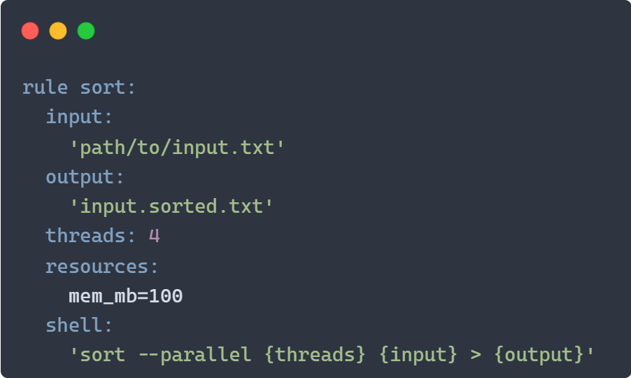
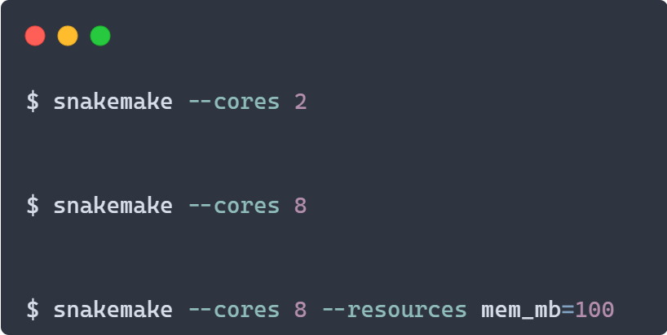
Snakemake Scheduling
Available jobs are scheduled to maximize parallelization while satisfying resource constraints
1 sort job using 2 threads
2 sort job using 4 threads each
1 sort job using 4 threads

Slide 21
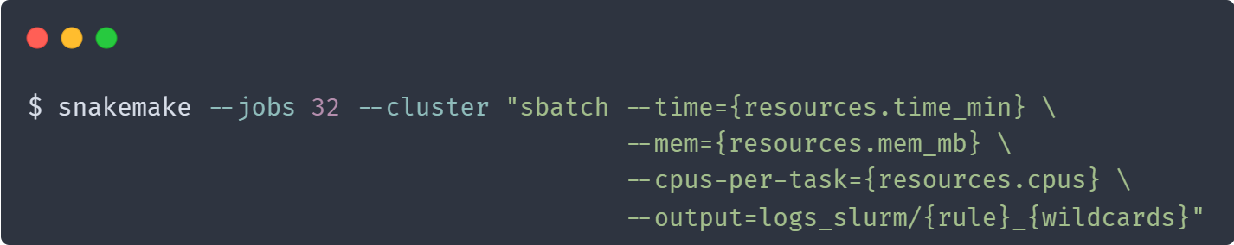
Managing Resources and Cluster Execution
The submit command can be decorated to make it aware of certain job properties: (name, rule name, input, output, params, wildcards, log, threads…)

Slide 22
Cluster Execution: be nice to the scheduler…
… and your fellow users
If too many requests are made at once to the job scheduler, the performance will suffer for all users
If the rules in your Snakemake jobs take minutes to complete, it's overkill to check their status every second. In that case, it may be desirable to set the following option:
--max-jobs-per-second
--max-status-checks-per-second

Slide 23
Using a Configuration File
When running workflows on a regular basis, it might be tedious to provide all the required flags every time
It is possible to specify a configuration profile to specify the default options using the --profile profile_name command line option
Snakemake will search for a folder named profile_name in the user and global configuration directories (~/.config/snakemake). You can also provide an absolute or relative path to a directory
In the folder, Snakemake expect to find a file named config.yaml

Slide 24
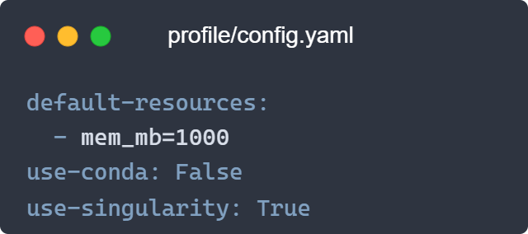
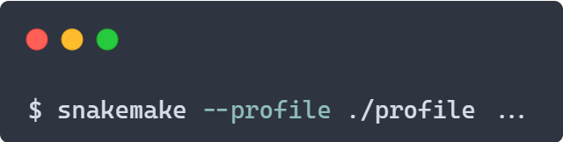
Using a Configuration File
The profile can be used to set a default for each option of the Snakemake command line
In a profile, command-line option --someoption becomes someoption
See also: https://github.com/snakemake-profiles/doc

Slide 25
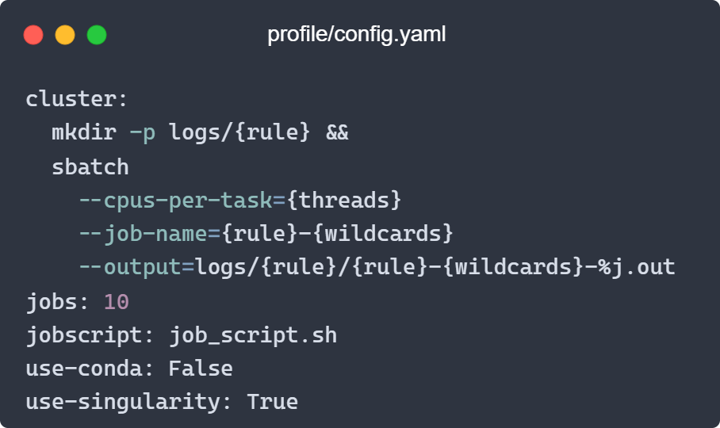
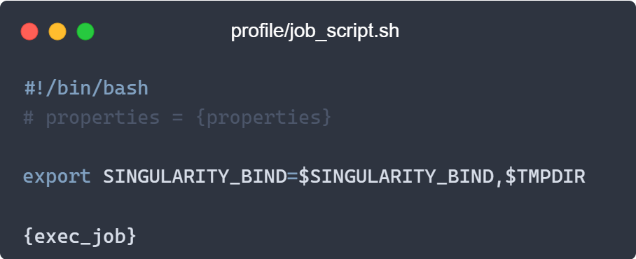
Using a Custom Job Script
You can provide a custom job script for submission to a cluster using the --jobscript command line option or use a profile
This allows you to perform additional operations in your job script
For example, it can be used to add additionnal binding when using singularity

Slide 26
Wrapping up

Slide 27
Snakemake is a workflow manager offering a simple Python-like syntax with high readability and flexibility
Snakemake allows for easy mixing of shell commands and high-level language scripts (Python, Julia, R, Rust)
Reproducibility and dependencies management of the workflow can be achieved through the integration with the Conda package manager and containers
Snakemake provide mechanisms to manage resources and cluster execution

Slide 28
Get More Information About Snakemake
Website: https://snakemake.github.io/
Documentation: https://snakemake.readthedocs.io/en/stable/

Slide 29



This training material has been created in the framework of the EuroCC project
The EuroCC project has received funding from the European High-Performance Computing Joint Undertaking (JU) under grant agreement No 951732. The JU receives support from the European Union’s Horizon 2020 research and innovation program and Germany, Bulgaria, Austria, Croatia, Cyprus, the Czech Republic, Denmark, Estonia, Finland, Greece, Hungary, Ireland, Italy, Lithuania, Latvia, Poland, Portugal, Romania, Slovenia, Spain, Sweden, the United Kingdom, France, the Netherlands, Belgium, Luxembourg, Slovakia, Norway, Switzerland, Turkey, Republic of North Macedonia, Iceland, Montenegro.

